Slide 1
Board of County Commissioners
Workshop
May 21, 2026
2:00 p.m.
Columbia County School Board Administrative Complex

Slide 2
Municipal Services Taxing Unit
This is not an assessment. Must use normal Truth in Millage (TRIM) process
    Discuss two (2) separate MSTU's – 1) EMS and 2) Law Enforcement
    Study is Draft last revised May 21, 2026
Need to adopt an ordinance prior to July 1
    At tonight's meeting, call for a public hearing on the ordinance for June 18
    City of Lake City and Town of Fort White need to adopt an ordinance prior to June 18
Set Preliminary Millage and Rollback Rates by July 23
Mail TRIM notices by August 13
First Public Hearing on Budget and Final Millage Rates on September 3
Second Public Hearing on Budget and Final Millage Rates on September 17

Slide 3
AmeriPro Compliance Times
March 2026
Total Urban Responses = 456
Met Urban Reponse Compliance Time = 56%
Total Rural Responses = 277
Met Rural Response Compliance Time = 64%
April 2026
Total Urban Responses = 451
Met Urban Reponse Compliance Time = 60%
Total Rural Responses = 269
Met Rural Response Compliance Time = 63%

Slide 4
AmeriPro Compliance Times Cont.
May 2026 Thus far
Total Urban Responses = 420
Met Urban Reponse Compliance Time = 70%
Total Rural Responses = 225
Met Rural Response Compliance Time = 64%

Slide 5
AmeriPro Staffing Levels
Contracted Staffing Levels
Provided Staffing Levels after 60 day ramp up
5 – 24-hour ALS Ambulances
1 – 12-hour ALS Ambulance
1 – 24-hour ALS QRV Supervisor
A shift has 3 - 24-hour units
B shift has 4 - 24-hour units, 1 - 12-hour unit
C Shift has 3 – 24-hour units
*These numbers have slightly improved since the 60-day ramp-up period ended, and AmeriPro states they are fully staffed now and awaiting employees to finish orientation.

Slide 6
EMS Rural County Comparison
Surrounding EMS Services
Columbia County Contracted Coverage
Putnam = 13,881 EMS calls per year with 9 ALS Ambulances, 1,542 calls per unit.
Nassau = 8,978 EMS calls per year with 9 ALS Ambulances, 997 calls per unit.
Gadsden = 8,637 EMS calls per year with 6 ALS Ambulances, 1,439 calls per unit.
Suwannee = 7,242 EMS calls per year with 5 ALS Ambulances, 1,448 calls per unit.
Bradford = 6,075 EMS calls per year with 4 ALS Ambulances, 1,518 calls per unit.
In 2025 Columbia County had15,000 calls for EMS service. The current EMS contract calls for 5 24-hr units and 1 12-hr Ambulance, resulting in 2,725 calls per unit.

Slide 7
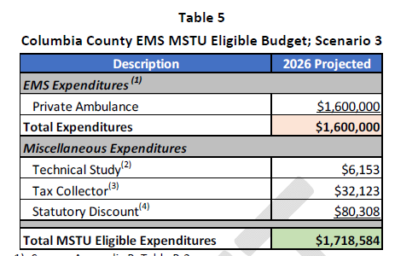
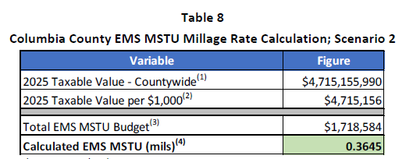
EMS MSTU
Existing Contract for Services

Slide 8
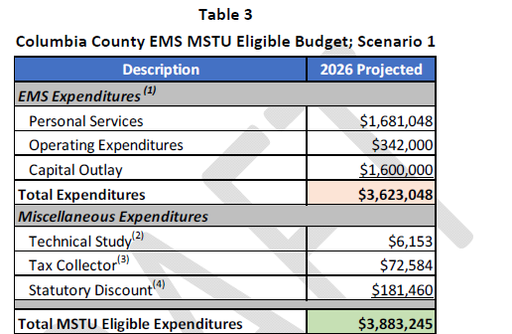
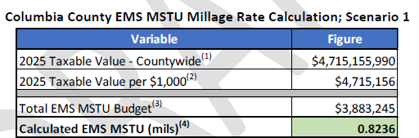
EMS MSTU
EMS – Two County Ambulances on Road
Not including Contract

Slide 9
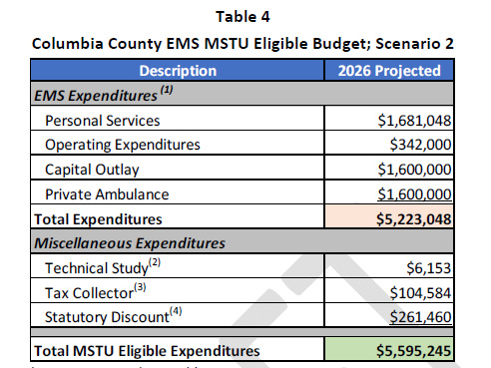
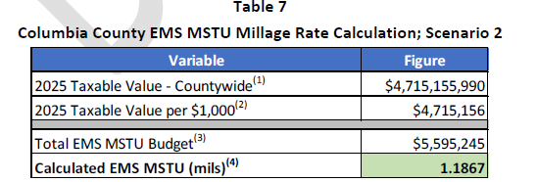
EMS MSTU
Two County Ambulances and Contract Services
MSTU Increase 1.1867
Existing GF Millage 7.815
Millage Decrease 0.3645
New GF Millage 7.4505

Slide 10
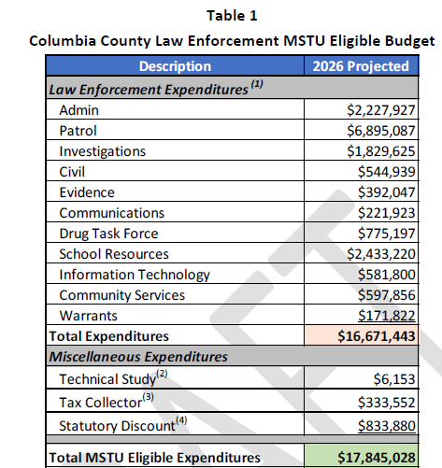
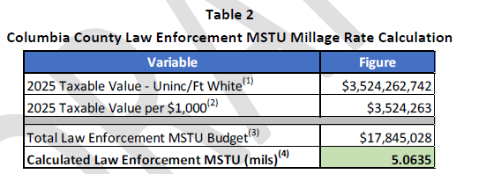
MSTU Law Enforcement
Adopted Budget for Ad Valorem Revenues is $36,649,153
      Current Millage is 7.815
Sheriff's Office Adopted Budget is $23,960,492
New GF Millage 2.7515
MSTU Millage 5.0635

